Slide 1

THE DIAMONDS ONLINE JOB PORTAL
BATCH 124 : TEAM 6 (DIAMONDS)
Team members
1.Avinash Tangudu (user6)
2.Chaitanya Reddy Sagam (user4)
3. Reddy Chaitanya Sravanthi (user5)
4.Prasanthi Vallabhasetti (user30)
5.Vanisha Chowdary Kantipudi (user41)
Mentor – Shubham S

Slide 2

PROJECT OUTLINE
Problem Statement
Objective
Project Overview
Architecture
AWS Deployment Architecture
Deployment model
Application Flow
Technology and Tools Used
Advantages
Conclusion

Slide 3
PROBLEM STATEMENT
The online job portal system is a platform between job seekers and job providers (company). The Job seeker can easily find and apply for a job by login into the system.
The Employer or company can easily get an expert employee from our job portal site by posting a job.
Create a web application for a company that will be used by job seekers to apply to the job requirements.
We will create a front end where users will view jobs. There will be a login page which also has register functionality.
The user will be taken to the home page after login, where they can view different jobs.

Slide 4

OBJECTIVE
Our objective is to provide best user experience to a job seeker so that he can search and apply for a job online
We created a front end where users will view jobs
There will be a login page which also has register functionality
The user will be taken to the home page after login, where they can view different jobs
Users can find jobs depending on different categories
User can update his/her profile including qualification
User can change his/her password
User can apply and delete the job request

Slide 5
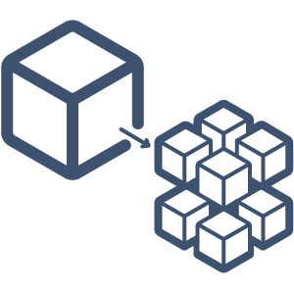
MICRO SERVICES
AUTHENTICATION API
FAVORITE API
EXTERNAL
API

Slide 6
PROJECT OVERVIEW
Login
Apply Job
Authentication API
Favorite API
Home
Search Jobs
Register
Dashboard
View
Jobs
SQL
Server
SQL
Server
External API

Slide 7
PROJECT ARCHITECTURE
Authentication API
JWT validator
SQL Server
Login/Register
POST request
Token generated
POST /GET/
DELETE
Front End
Angular
User services
Get favorite
Delete favorite
MYSQL DB
GET/DELETE
GET
Search Job
External API
GET

Slide 8
PROJECT WORK FLOW :
USER
Home
Login
Register
Dash board
Search Jobs
View Jobs
Applicant Profile
Apply Jobs
Delete Application
Edit Profile
Edit Password

Slide 9
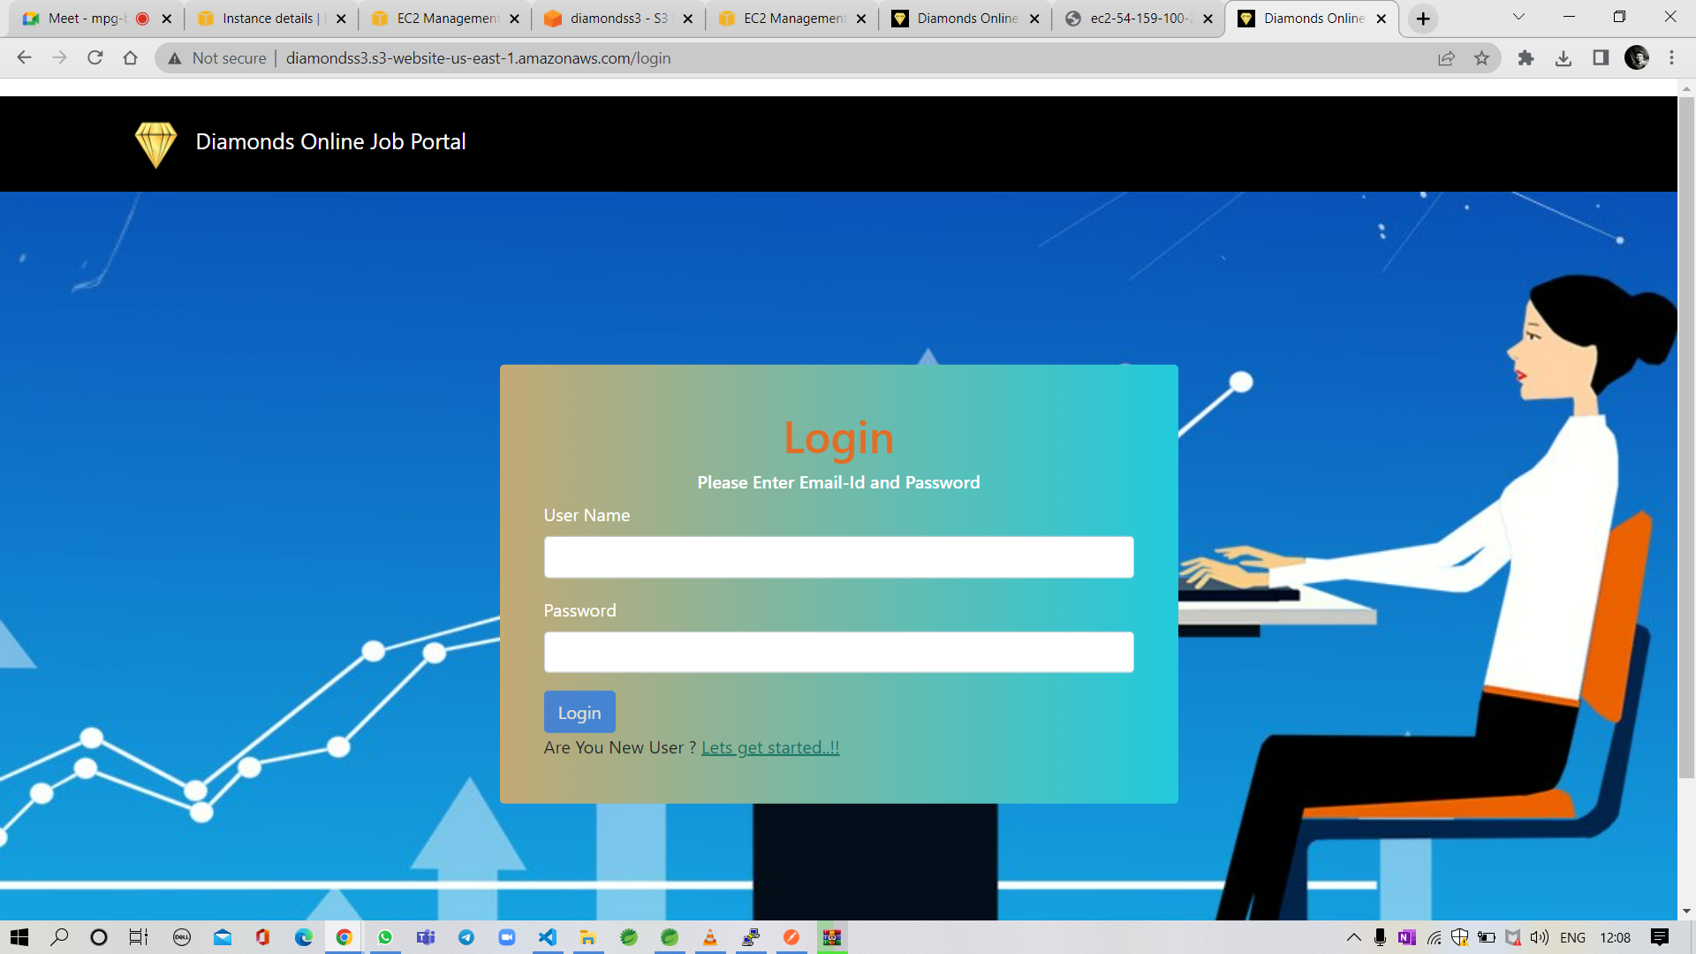
REGISTRATION PROCESS
1. Login in to online portal (if you are a old user)

Slide 10
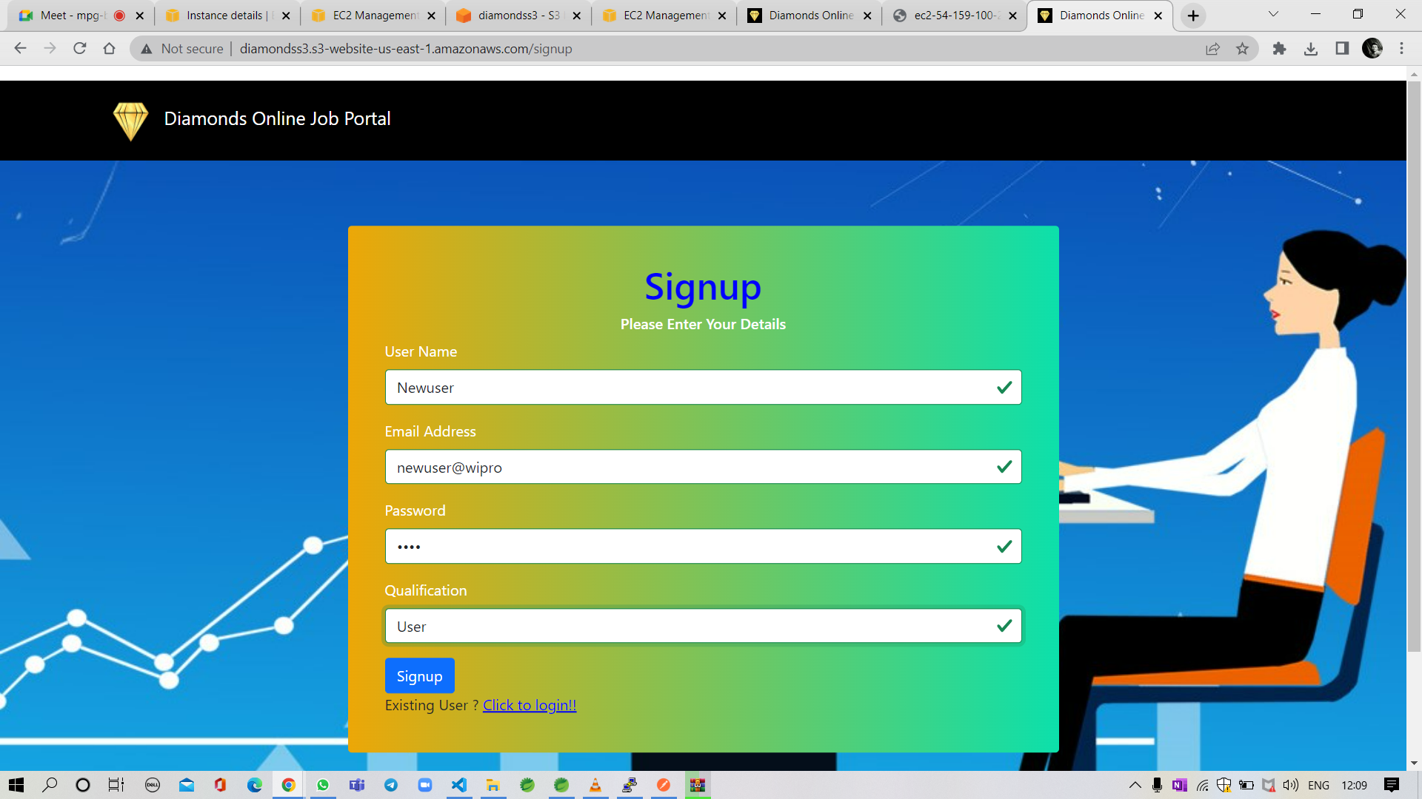

2. If you are new user give your credentials and it will redirect to login page and here you can login to the website

Slide 11

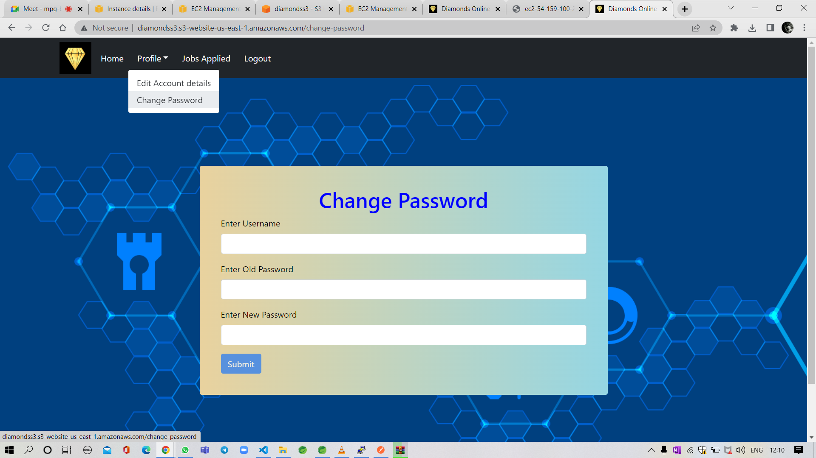
PROFILE UPDATE AND CHANGE PASSWORD

Slide 12
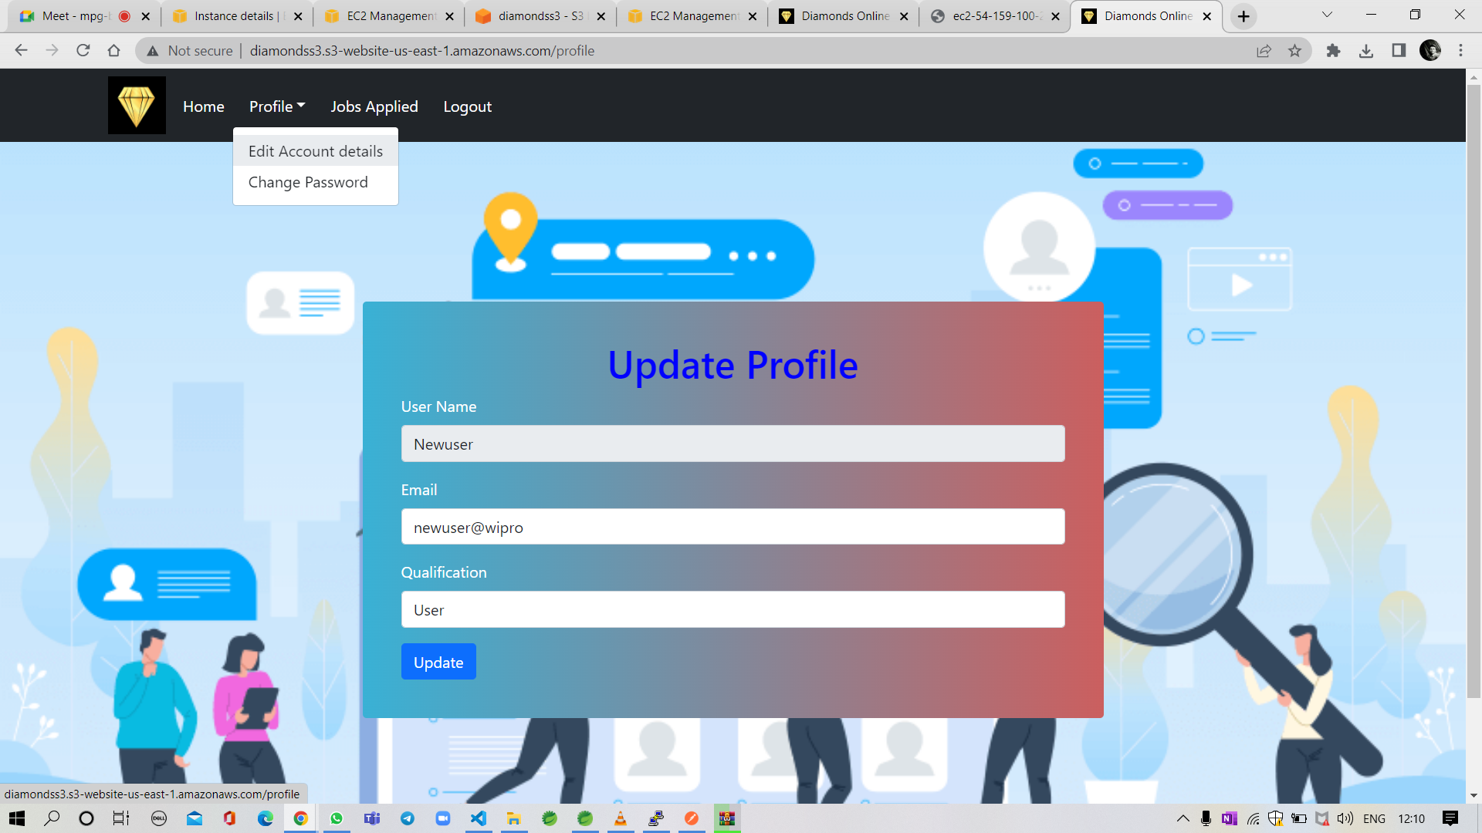

Slide 13
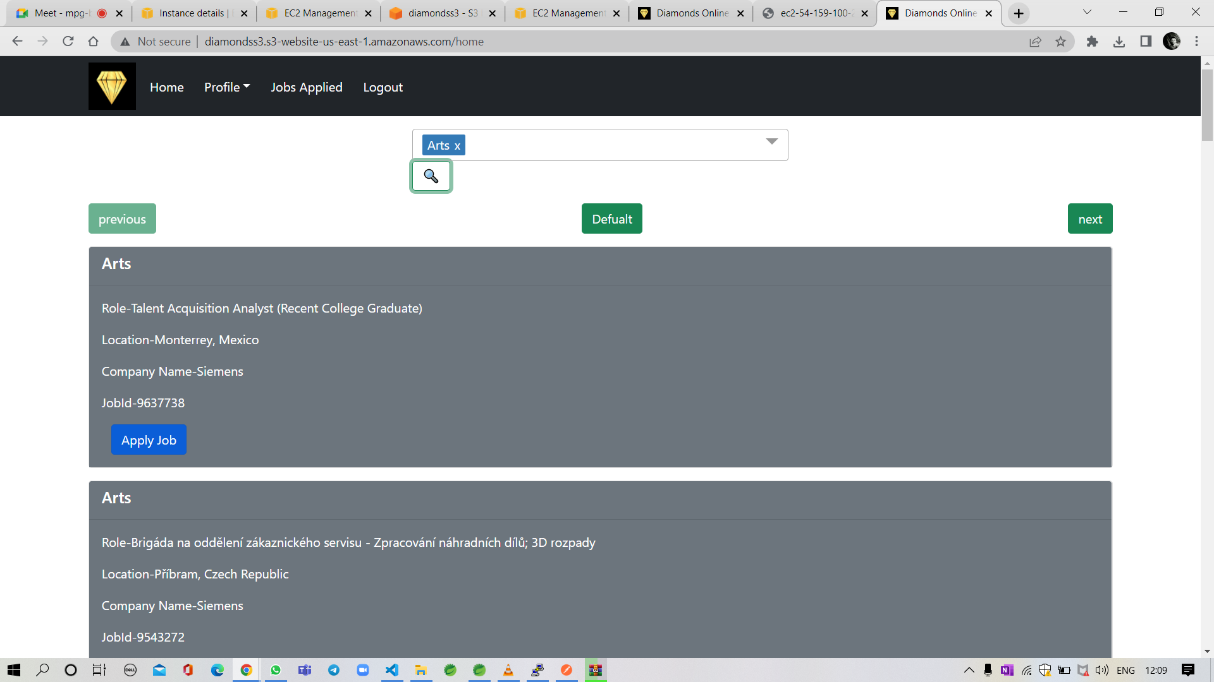
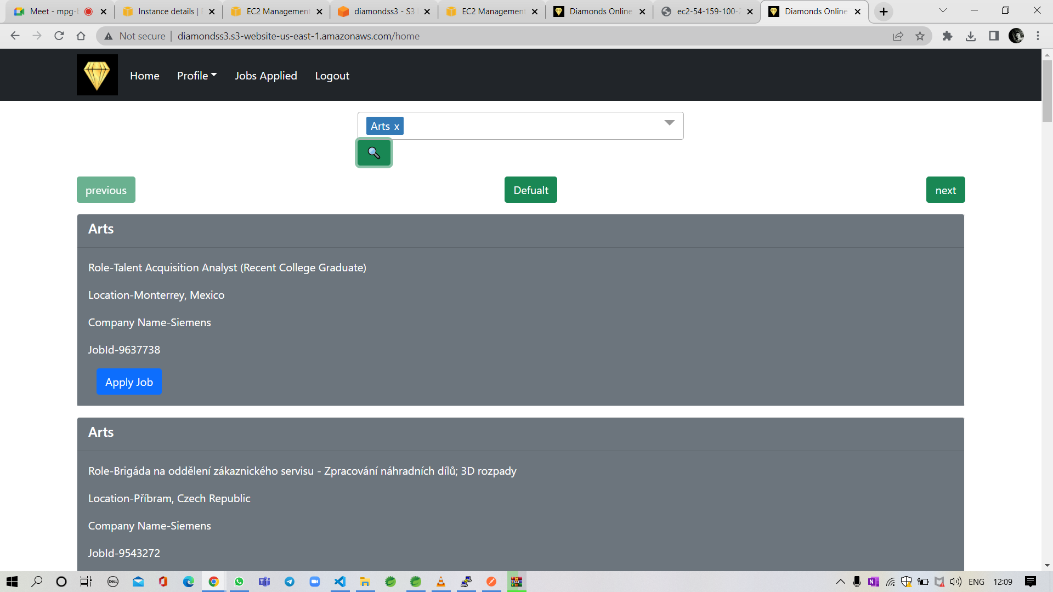
SEARCH JOBS BY CATEGORY AND APLLY JOB

Slide 14
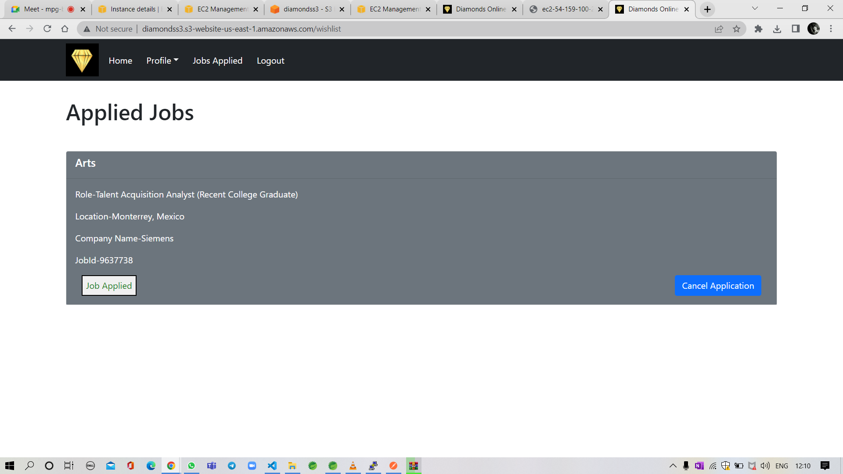

Slide 15
DEPLOYMENT ARCHITECTURE
EC2
S3 Bucket
ANGULAR
SPRING BOOT
RDS
CLOUD WATCH
MySQL

Slide 16
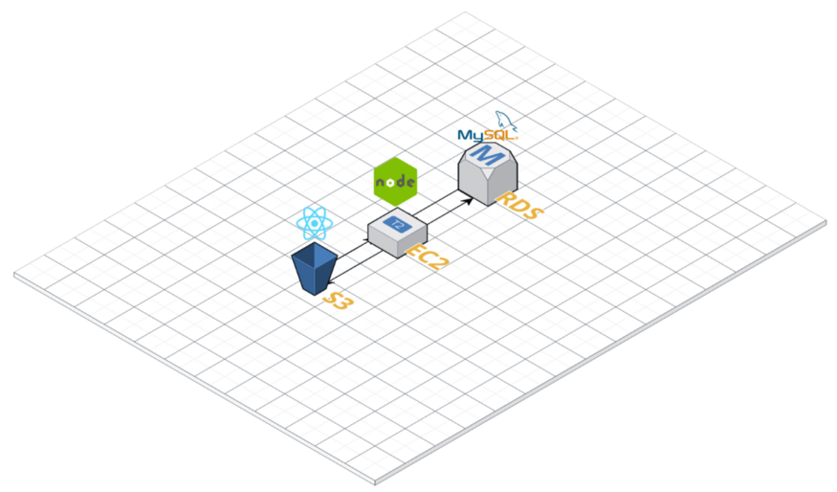
AWS DEPLOYMENT MODEL

Slide 17
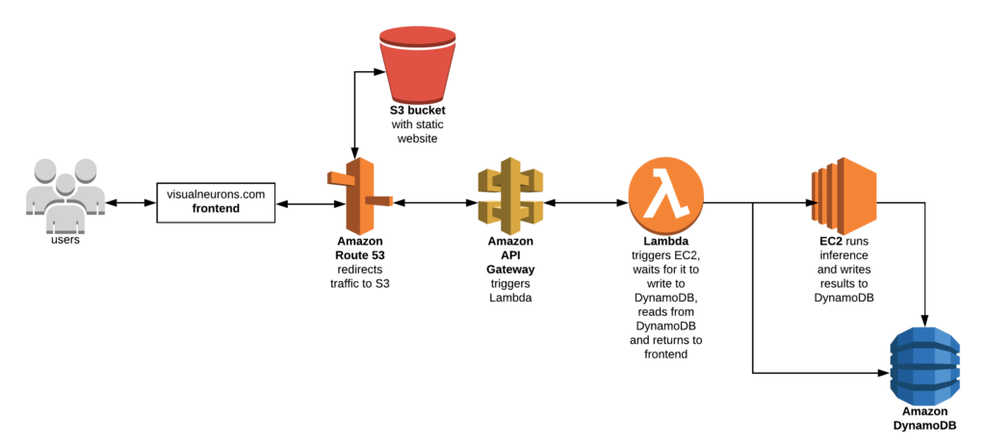

Slide 18
STEP WISE PROCESS OF DEPLOYING
WEB APPLICATION IN AWS
USING EC2,RDS,S3

Slide 19
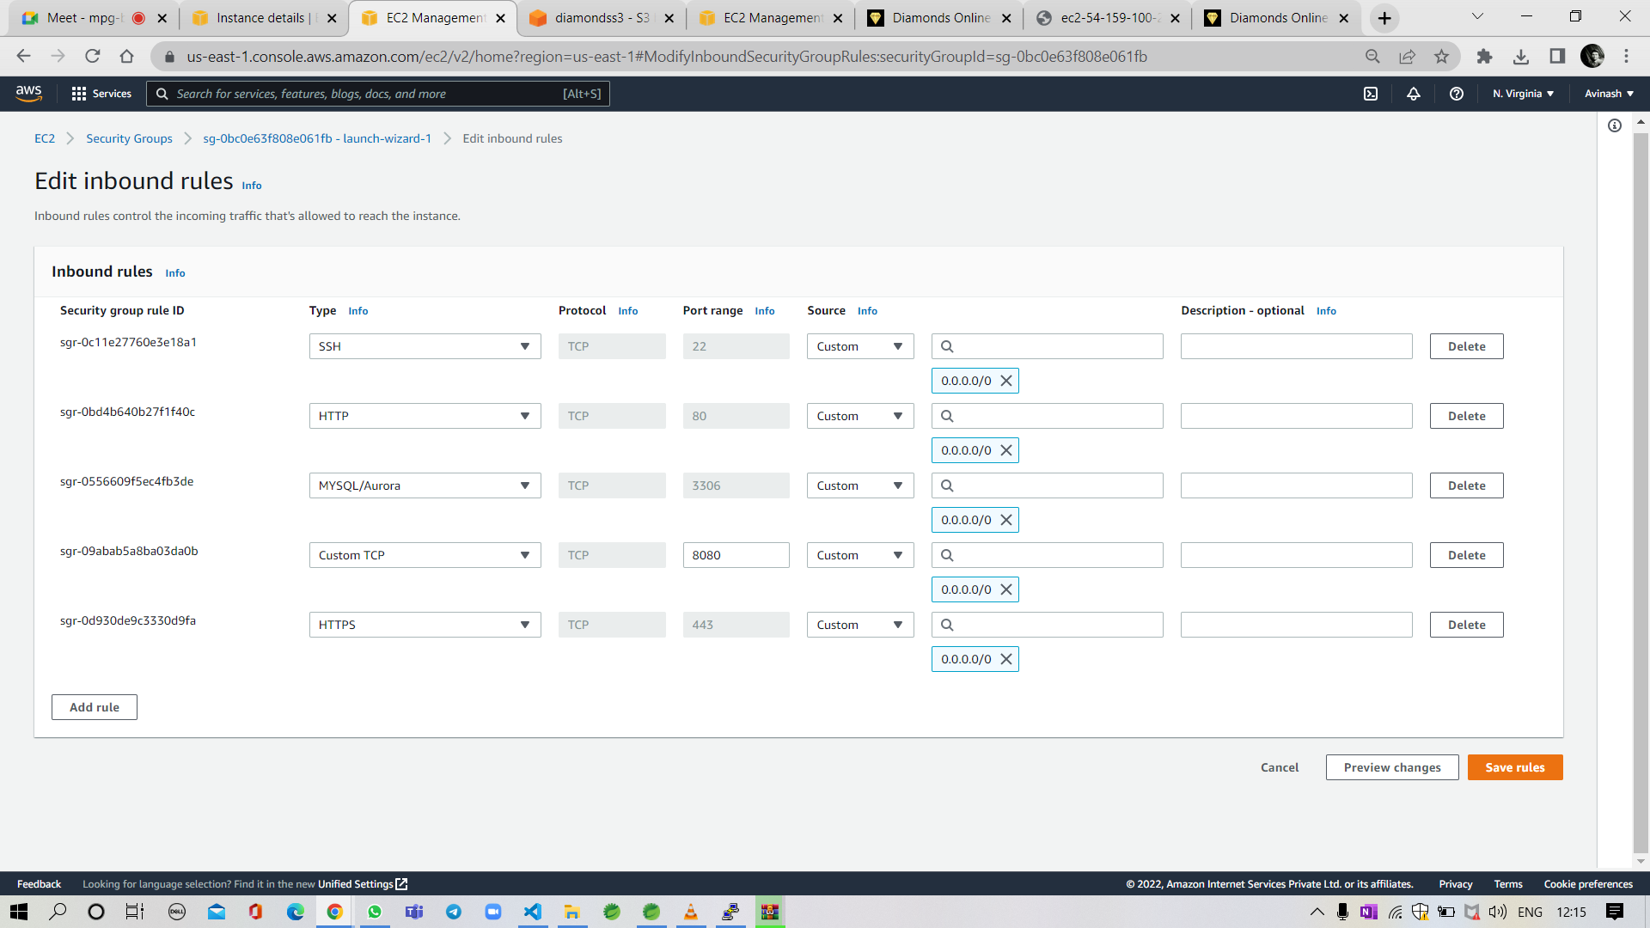
Launch an instance and open all the access ports to access application on web

Slide 20
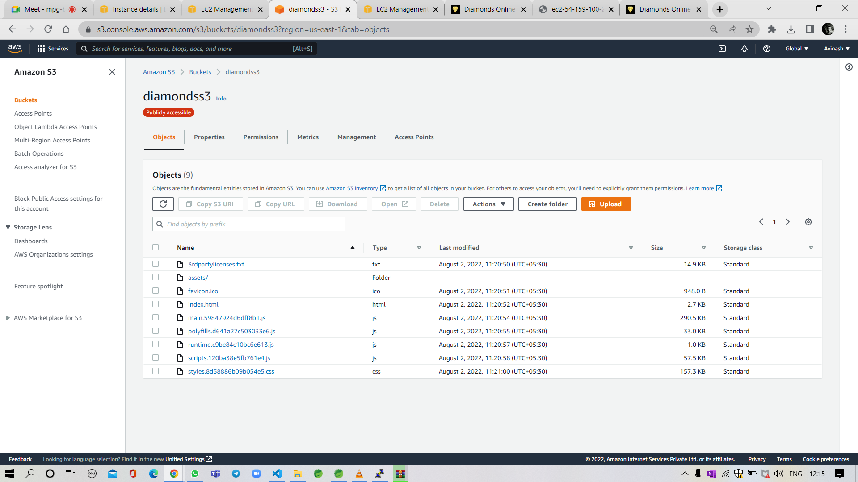
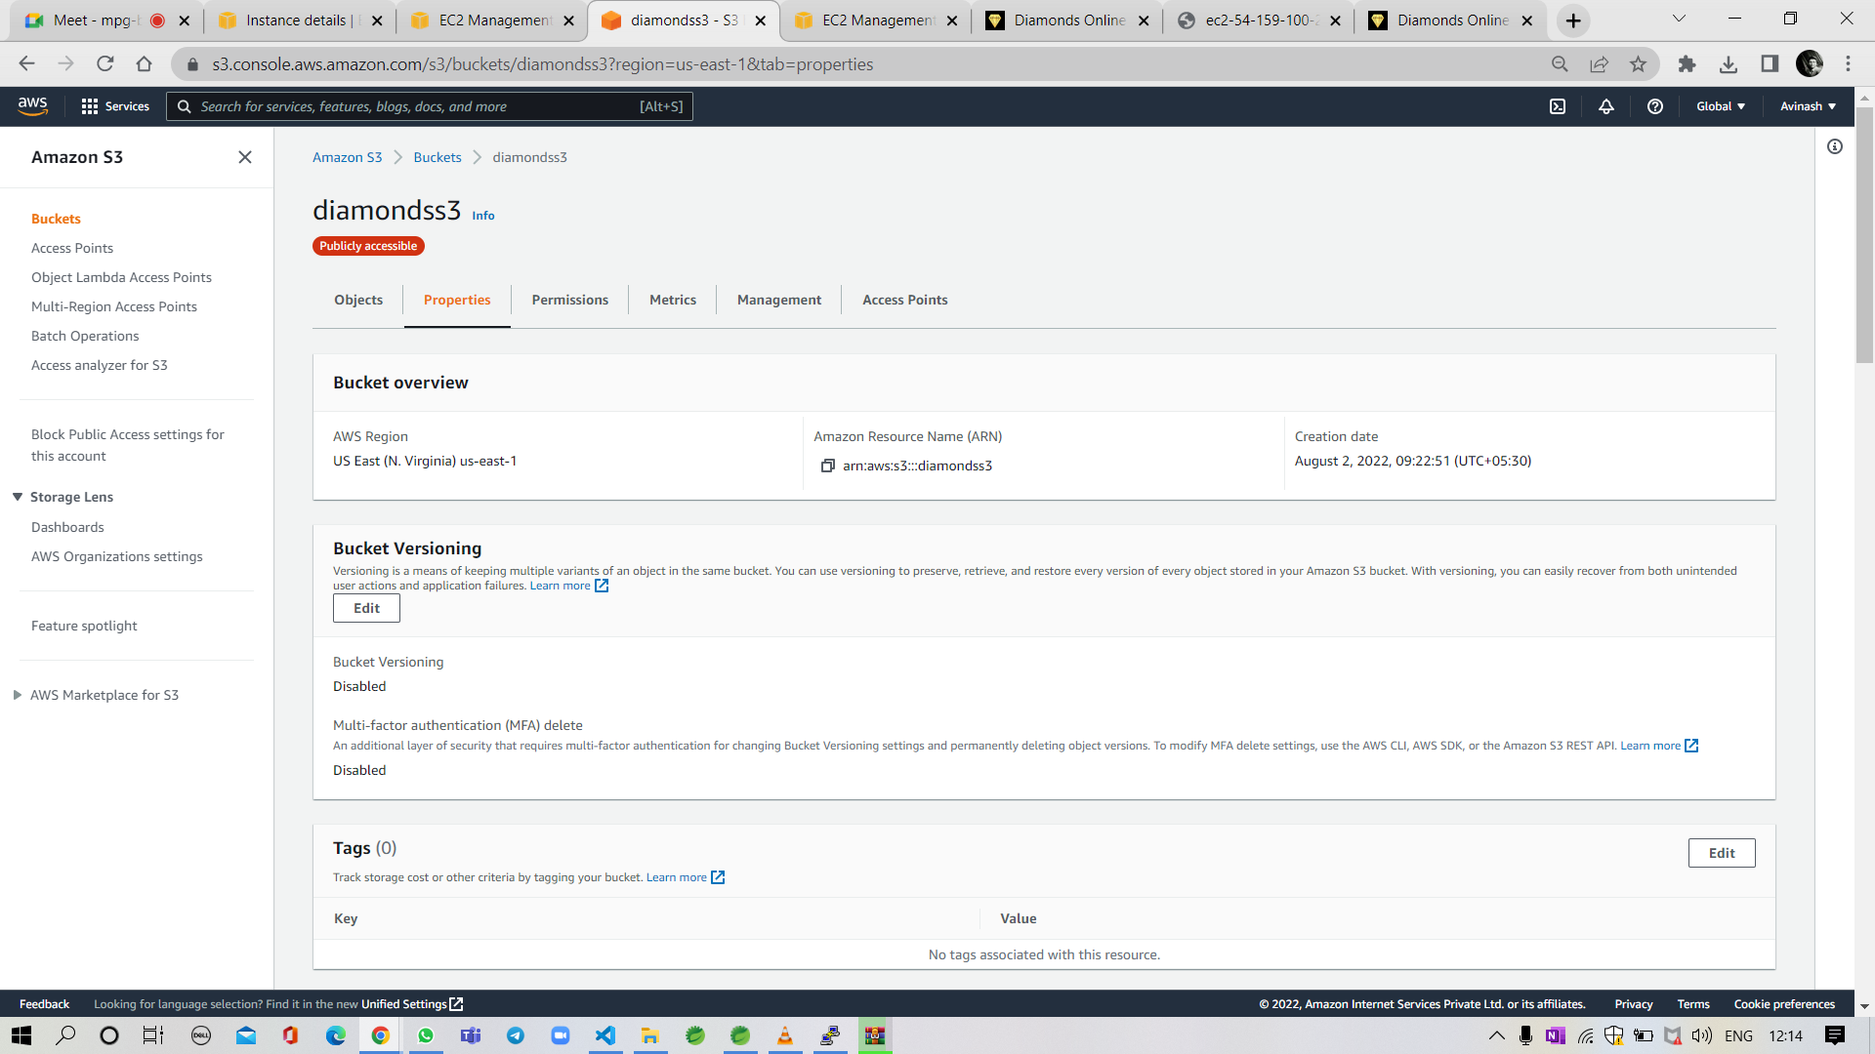
Create two S3 buckets ,upload angular and spring files of your application in S3 buckets.

Slide 21
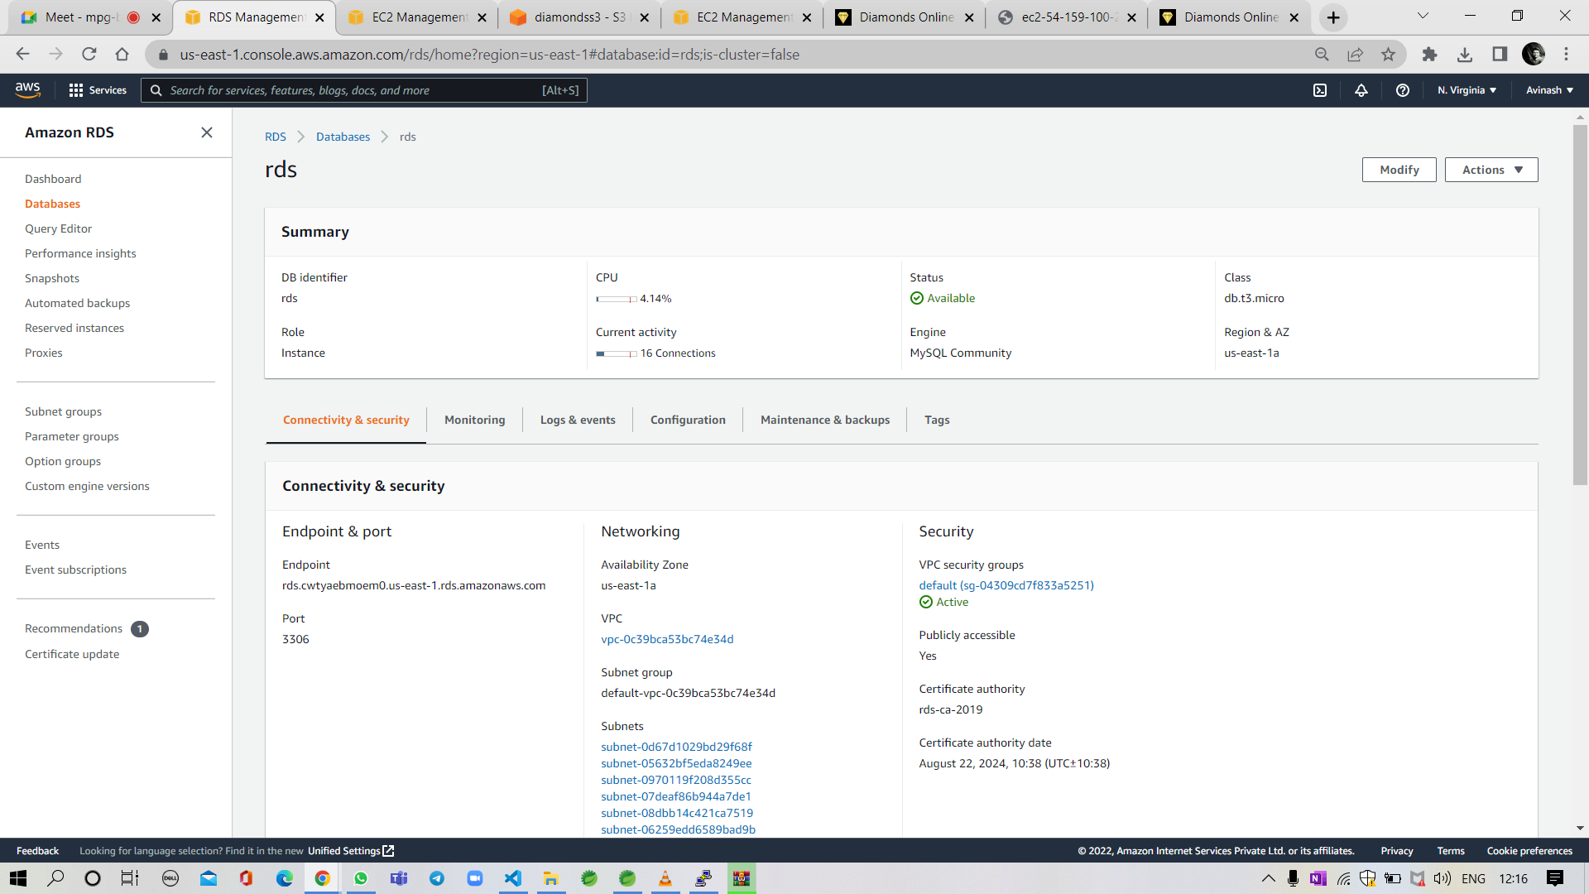
Create RDS with MySQL and copy the end point

Slide 22
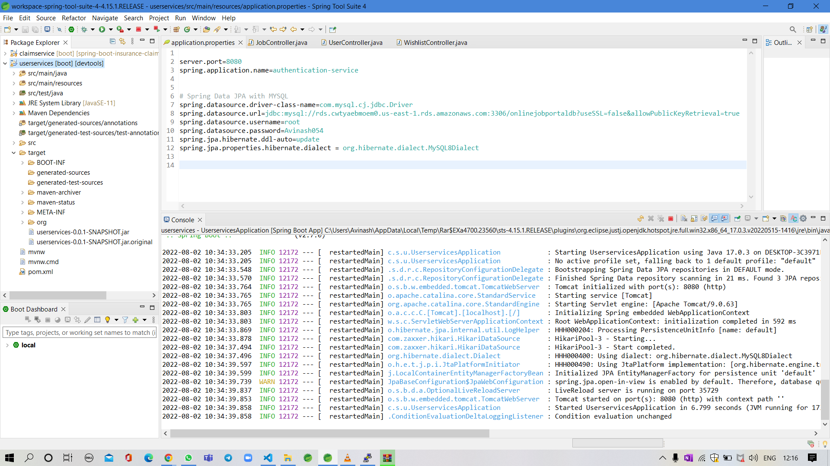
Copy the RDS and paste it on spring files to save the data in RDS .

Slide 23
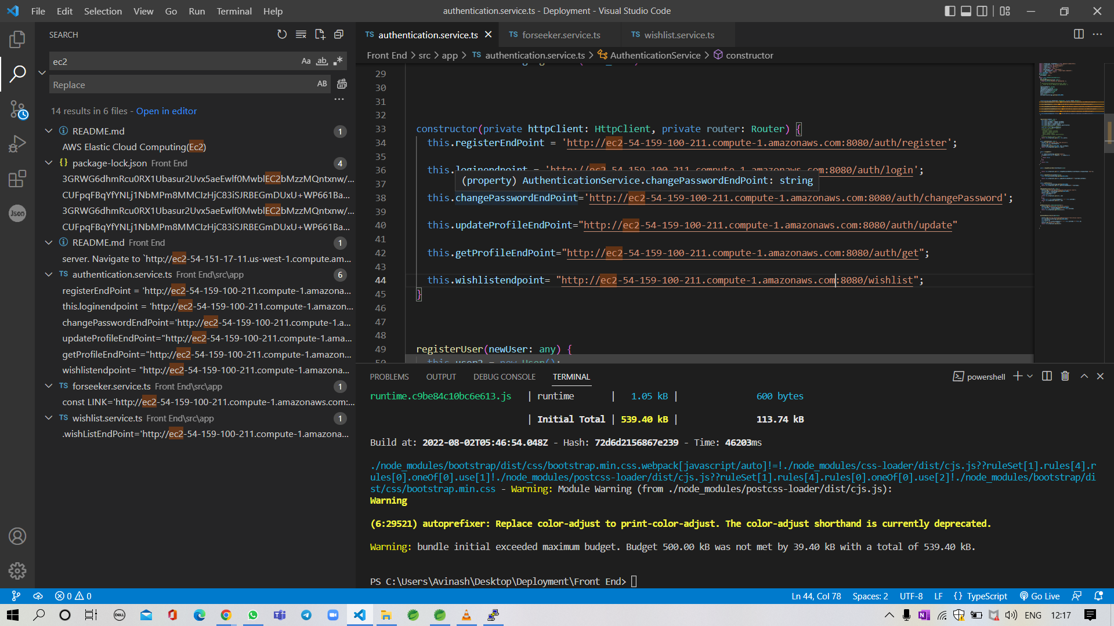
Paste the Ec2 Public IPV4 url in all the endpoints in both user and admin files

Slide 24
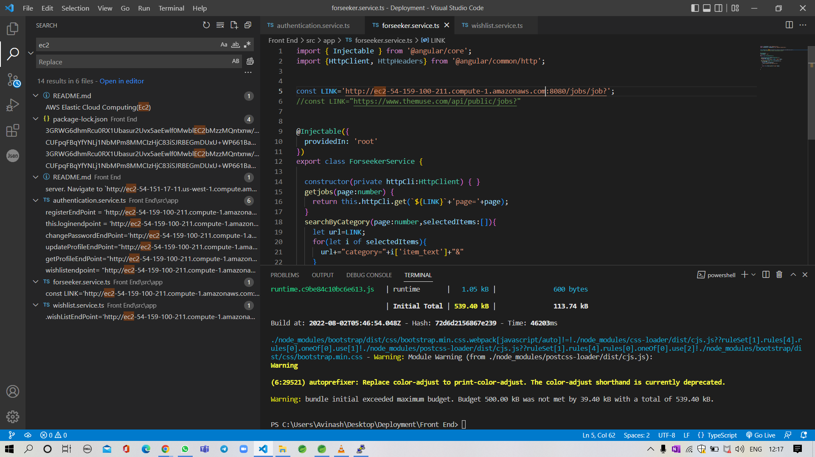

Slide 25
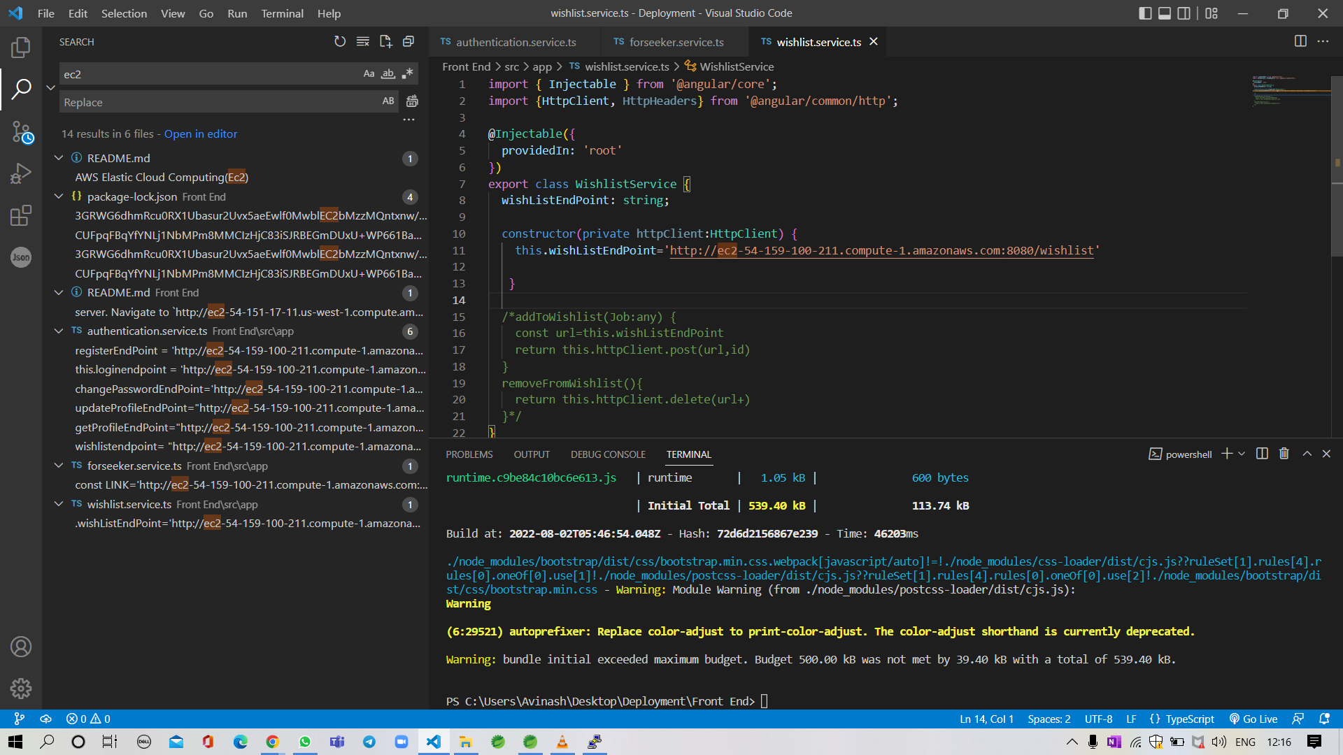

Slide 26

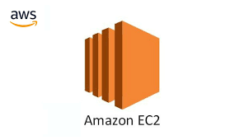








TECHNOLOGIES AND TOOLS USED :
Git lab
AWS EC2
AWS RDS
AWS S3
Vs code
Angular
MySQL
Spring boot
HTML & CSS
POSTMAN

Slide 27
RESPONSIVENESS OF WEBSITE
MOBILE VIEW
LAPTOP VIEW

Slide 28
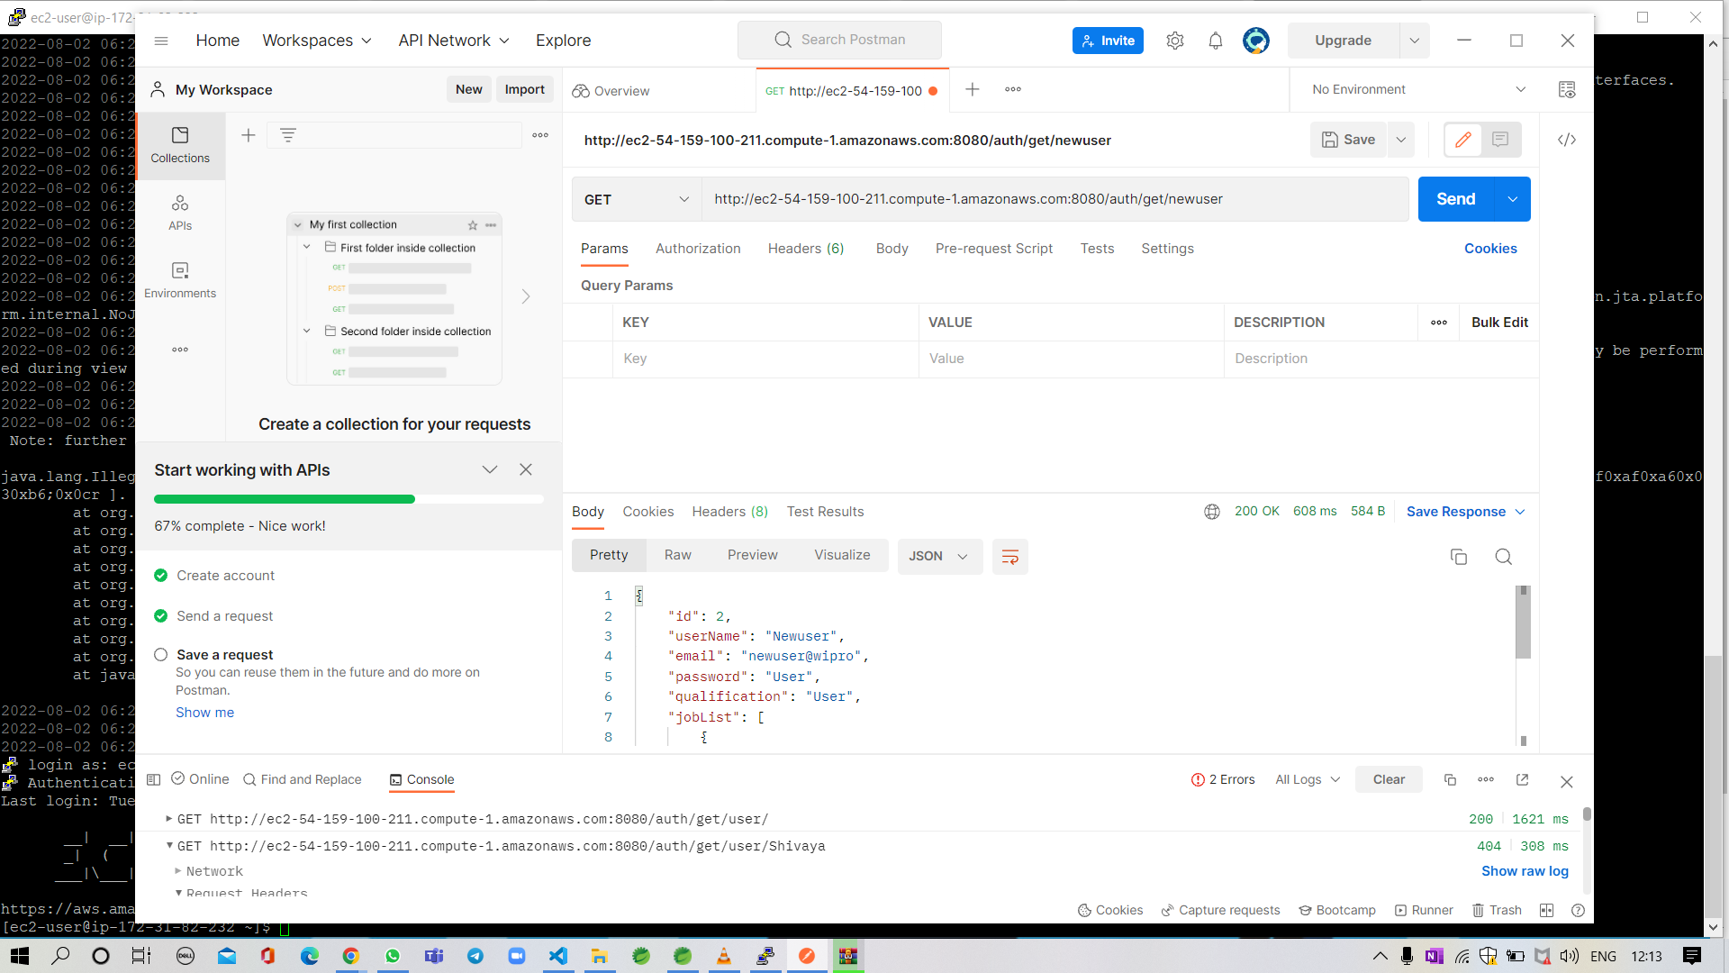
FETCHING USER DETAILS USING POSTMAN GET SERVICE - EMPLOYER SIDE

Slide 29
ADVANTAGES
Regular job updates
Online recruitment gives bigger audience
Easy job seeking and applying
Easy access to remove applied jobs
User friendly website
Can hire all streams of employees
Online recruitment is quick
Reduces time to hire

Slide 30
GITHUB LINK OF PROJECT FILES
https://github.com/AvinashTangudu054/Diamonds-online-job-portal

Slide 31
CONCLUSION
The Job Seeker can be able to register and login to the online job portal and can able to view the jobs in home dashboard page. Job seeker can also search the jobs based on category wise and apply those jobs, and also the applicant can cancel the applied jobs & the applicant can also be able to edit the profile and password.
By deploying this project in AWS we can be able to manage the data of registered users.

Slide 32


